Slide 1
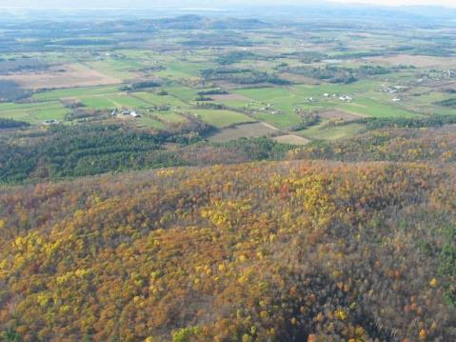
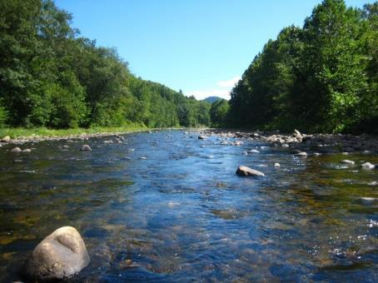



Vermont Conservation Design
Maintaining and Enhancing an Ecologically Functional Landscape
E. Sorenson, R. Zaino
J. Hilke & E. Thompson

Slide 2
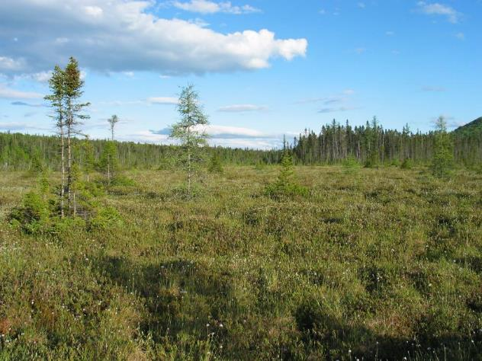
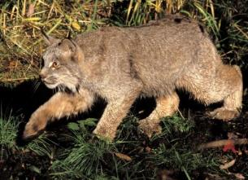
Collaborators: VT Fish and Wildlife Department
            Vermont Land Trust
            The Nature Conservancy
            VT Department of Forests, Parks & Recreation
            NorthWoods Stewardship Center

Slide 3
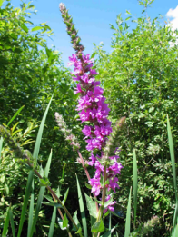
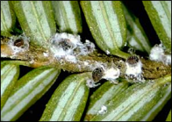
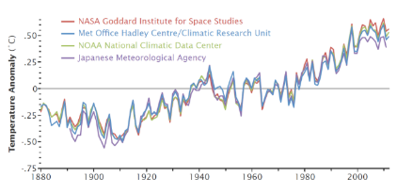
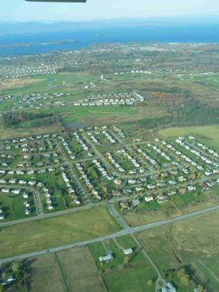
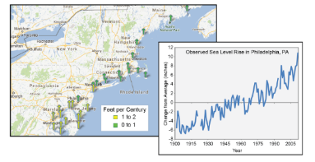
Primary Threats to Biological Diversity
  Population growth
  Habitat loss
  Habitat fragmentation
  Non-native, invasive species
  Climate change – direct and compounding effects
Climate Change Impacts in the US, 2014
NASA
Notes:
ES & JA

Slide 4
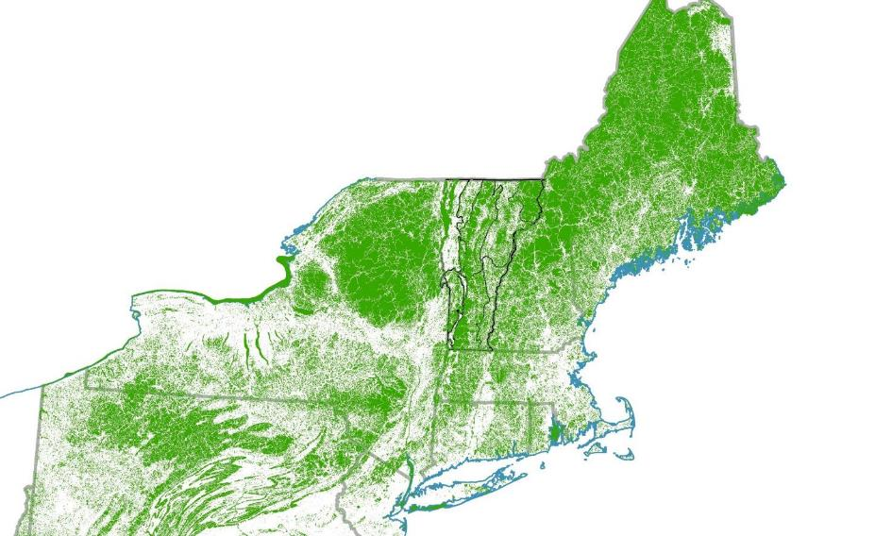
Blocks of Forest and other Natural Cover greater than 20 acres

Slide 5
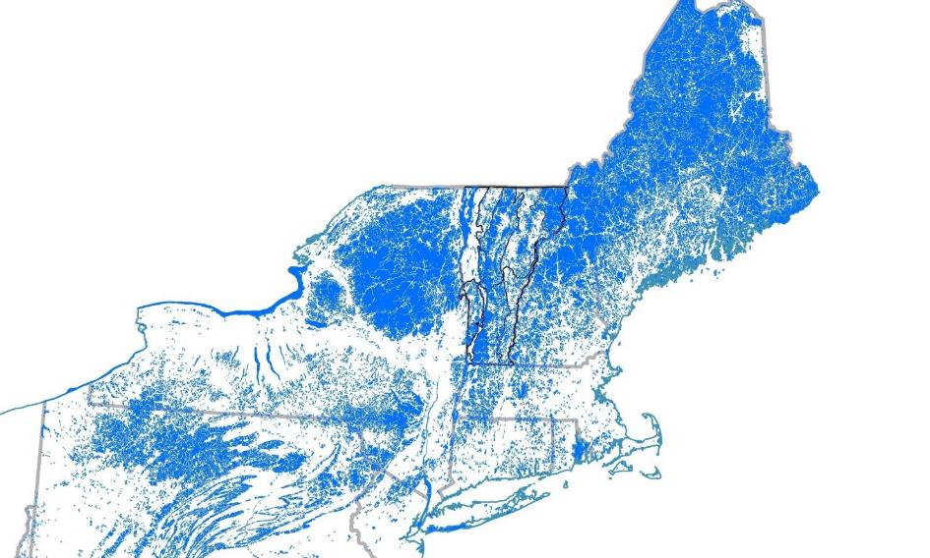
Blocks of Forest and other Natural Cover greater than 500 acres

Slide 6
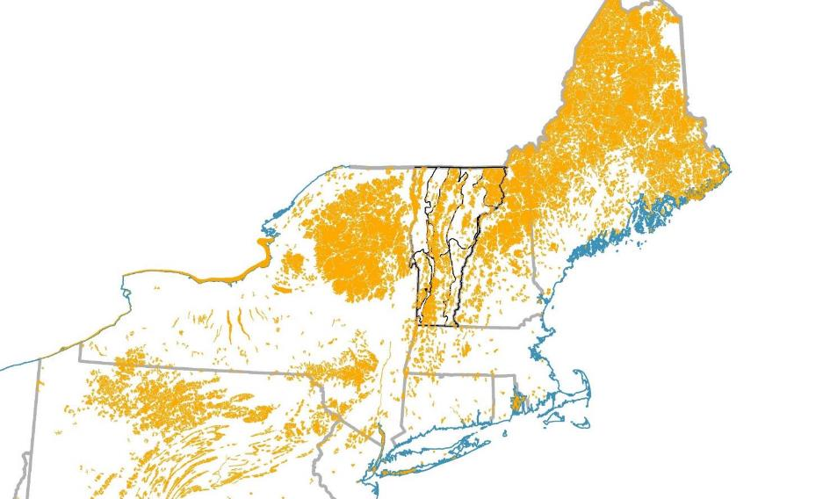
Blocks of Forest and other Natural Cover greater than 2,000 acres

Slide 7
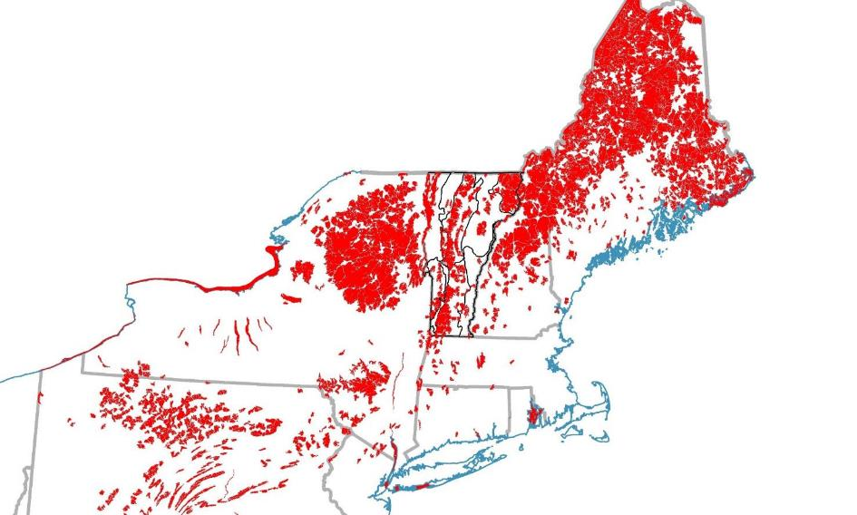
Blocks of Forest and other Natural Cover greater than 5,000 acres

Slide 8
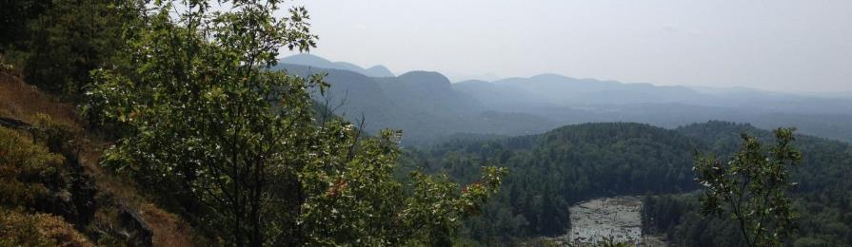
Vermont Conservation Design
A practical approach to protecting and enhancing an ecologically functional landscape into the future.
Uses two key landscape features: forest blocks and riparian areas.
Applies the coarse filter-fine filter approach to conservation.
Notes:
Ecologically functional landscape: large areas of connected forest, riparian areas, and natural communities that allow ecological processes to occur and species to access required habitat and shift across the landscape in response to climate change. Degree of functionality varies with landscape condition.

Slide 9
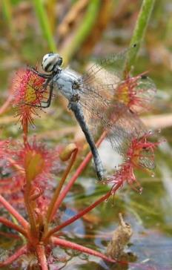
Given a broad goal of conserving biological diversity in Vermont...
And, an estimated 24,000 to 43,500 species in Vermont!
How do we protect them all?
Elfin Skimmer

Slide 10
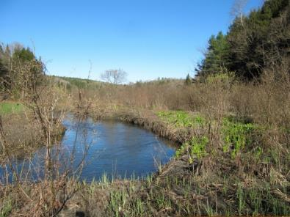
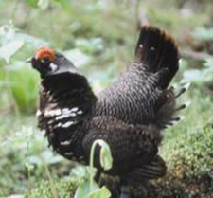
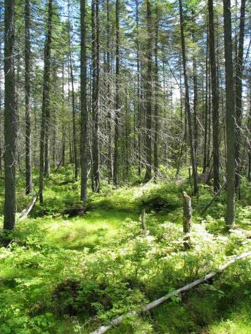
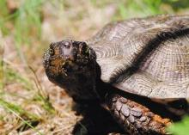
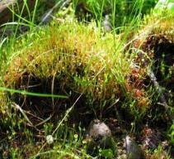
Coarse filter/fine filter approach to conservation
  If examples of all coarse-filter elements are conserved at the scale at which they naturally occur, most of the species they contain – trees, mammals, birds, insects – will also be conserved. Some species will always need special attention.

Slide 11
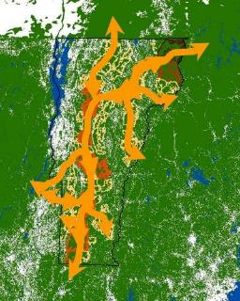
Climate Change Considerations
climate change has happened before
rapid and uncertain changes this time
need connectivity – species and processes
need to “conserve nature’s stage”
Davis and Shaw 2001

Slide 12
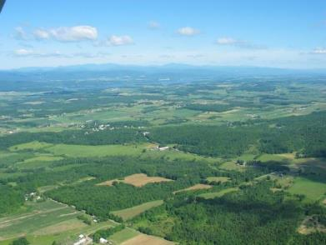
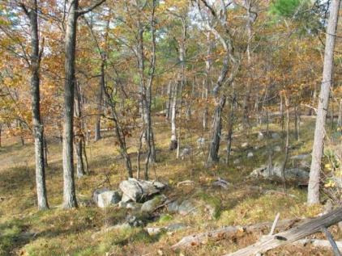
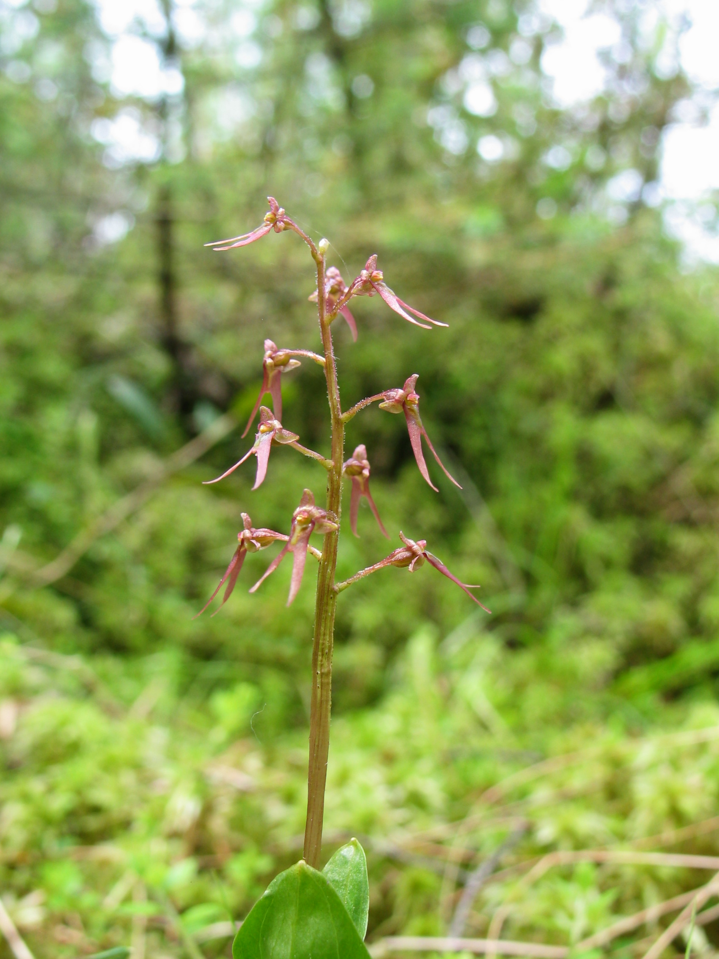
Conservation Design at Three Scales
Landscapes
Natural Communities
Species
Champlain Valley
Interior Forest Blocks
Connectivity Blocks
Surface Waters and Riparian Areas
Riparian Areas for Connectivity
Physical Landscape Diversity Blocks
and Wildlife Road Crossings
Dry Oak-Hickory-Hophornbeam Forest
Upland and Wetland
Aquatic
Vernal Pools…
Old Forest
Young Forest
(next two years)
Southern Twayblade (Listera australis)
Rare Species
Grasslands
Spp of Greatest Cons. Need
Deer
Pollinators…
(next two + years)
Notes:
Review use of table to identify which species and natural communities are “captured” by each landscape element – refining the elements

Slide 13
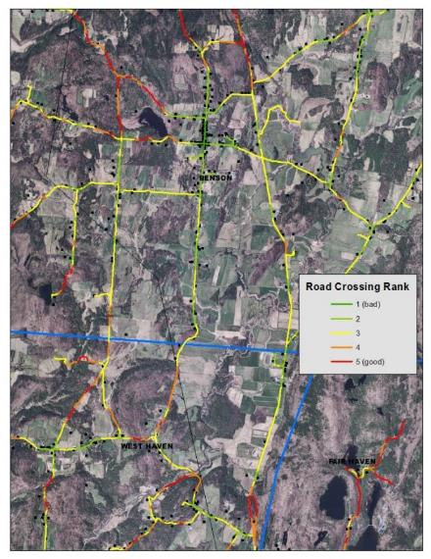
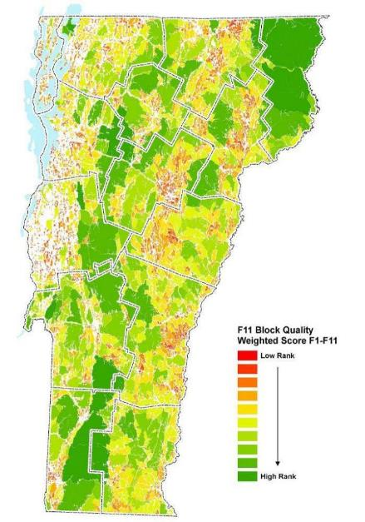
Forest Block project
4,055 forest blocks identified
Each block ranked for 11 biological and physical factors and total weighted score
Notes:
ES

Slide 14
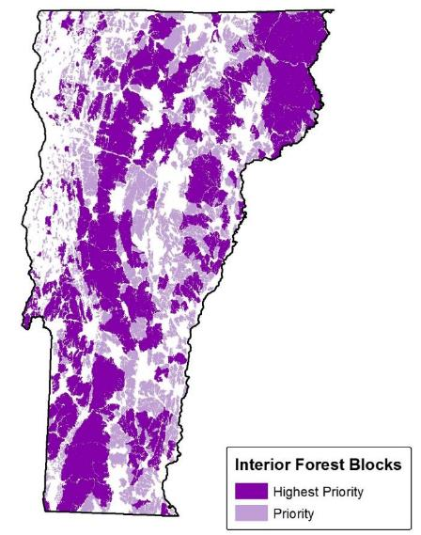
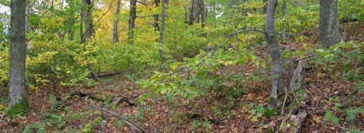
Interior Forest Blocks
Definition: Areas of contiguous forest and other natural communities and habitats that are unfragmented by roads, development, or agriculture.
Ecological Function:
Ecological processes
Air and water quality
Flood resilience;
Interior forest species
Wide-ranging mammals
Source populations
Large, topographically diverse forest blocks allow species to shift in response to climate change.

Slide 15
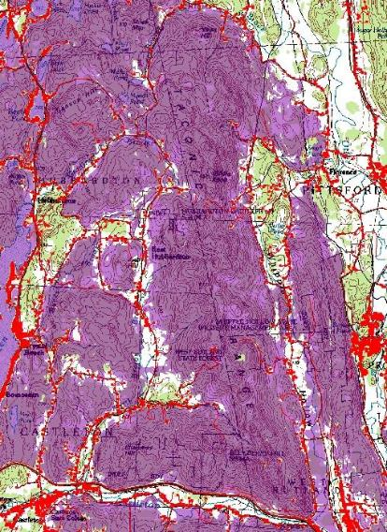
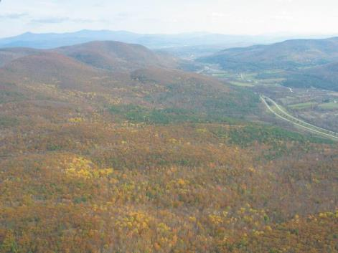
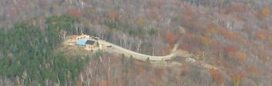
Interior Forest Blocks
Guidelines for Maintaining Ecological Function:
Maintain interior forest conditions;
Avoid development that creates interior forest fragmentation;
Limit development to the margins of existing forest blocks in areas not critical for connectivity;
Manage forests to maintain forest structure, distribution of age classes, and minimize invasive species;

Slide 16
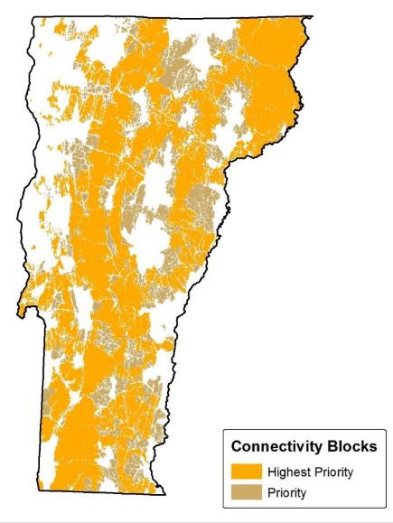
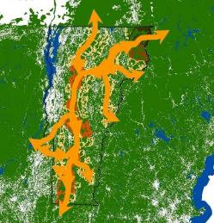
Connectivity Blocks
Definition: The network of forest blocks that together provide terrestrial connectivity at the regional scale (across Vermont and to adjacent states and Québec) and connectivity between all Vermont biophysical regions.
Ecological Function:
Wide-ranging animal ranges
Daily and annual habitat needs
Young animal dispersal
Plant and animal species range shift with climate and land uses change
Genetic exchange and other processes

Slide 17
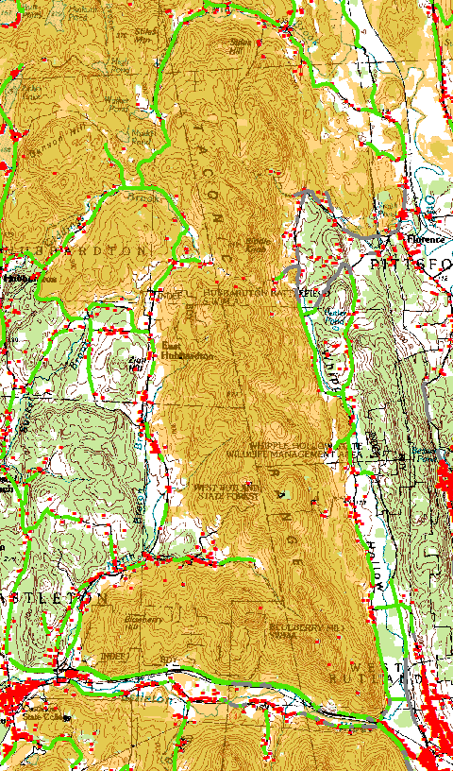
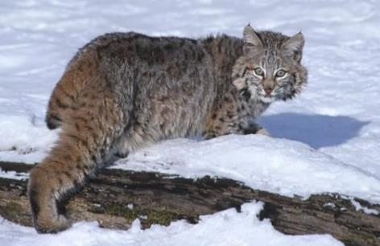
Connectivity Blocks
Guidelines for Maintaining Ecological Function:
Maintain interior forest conditions as with interior forest blocks;
Avoid development that creates interior forest fragmentation;
Maintain or enhance structural and functional connectivity at block margins where they border other connectivity blocks;
Limit development in these areas of block-to-block connectivity and maintain forest cover.

Slide 18
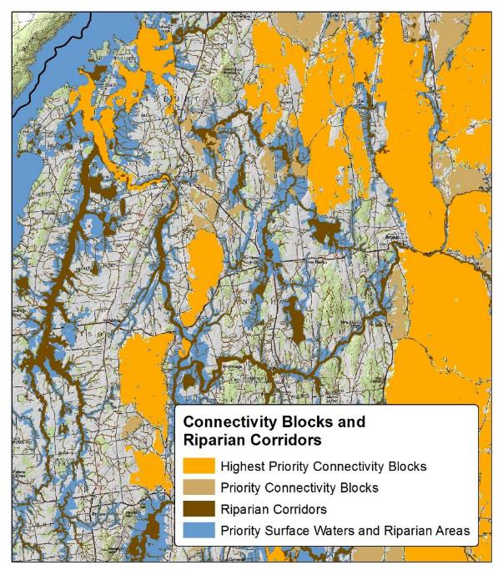

Connectivity Blocks and Riparian Corridors showing how the two landscape elements function together to provide connectivity in the fragmented Champlain Valley.

Slide 19
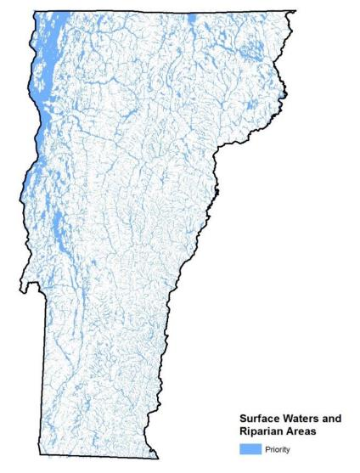
Surface Waters and Riparian Areas
Definition: The network of all lakes, ponds, rivers, and streams, their associated riparian zones and valley bottoms in which geophysical processes occur.
Ecological Function:
Aquatic species habitat
River geomorphic stability and floodplain access
Stabilize shorelines, store flood waters, filter and assimilate sediments and nutrients, shade adjacent surface water, and contribute organic matter
Biodiversity – species and communities
Wildlife corridors
Plant and animal range shifts in response to climate change

Slide 20
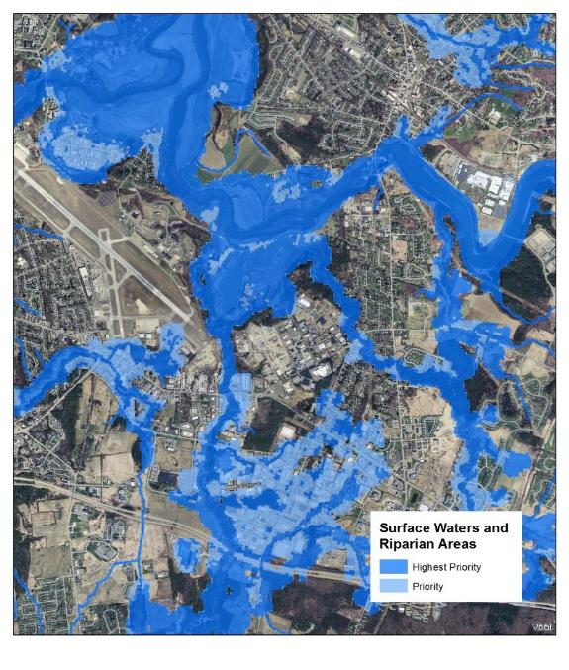
Surface Waters and Riparian Areas for the South Burlington, Essex, and Williston area.

Slide 21
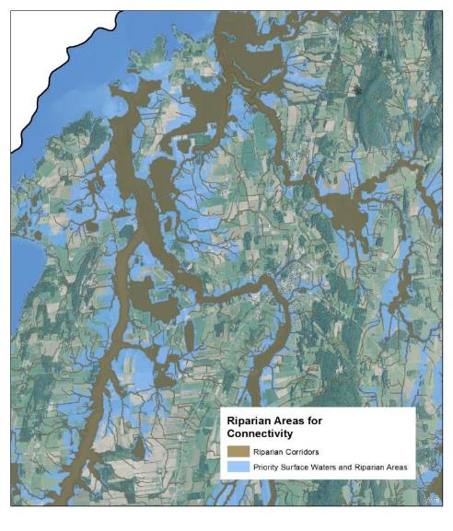
Riparian Areas for Connectivity (Riparian Corridors)
Definition: The connected network of riparian areas in which natural vegetation occurs, providing natural cover for wildlife movement and plant migration.
Ecological Function:
Integrity of the lakes, ponds, rivers, and streams
Wildlife cover movement
Obligate habitat for mink, otter, beaver, and wood turtle
Riparian areas and Connectivity Blocks together form a functional network.
Vicinity of Ferrisburgh, Panton, and Vergennes.

Slide 22
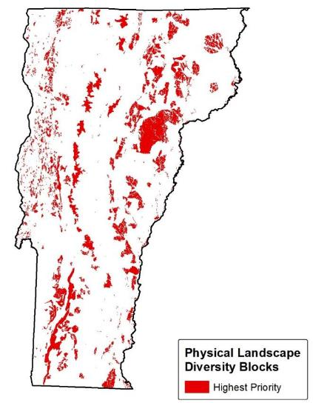
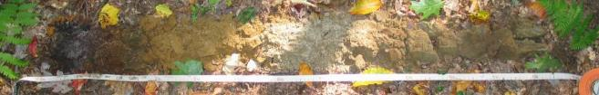
Physical Landscape Diversity
Definition: A set of forest blocks and other areas of natural vegetation that include physical landscape diversity features that are either rare in Vermont or under-represented in the other landscape elements.
Ecological Function:
Physical landscape diversity (bedrock, soils, elevation, landform,…) represents potential biological diversity.
“Conserving Nature’s Stage”

Slide 23
Physical Landscape Diversity Blocks
All of the physical landscape diversity components categorized by whether they are rare, representative, or responsibility features.

Slide 24
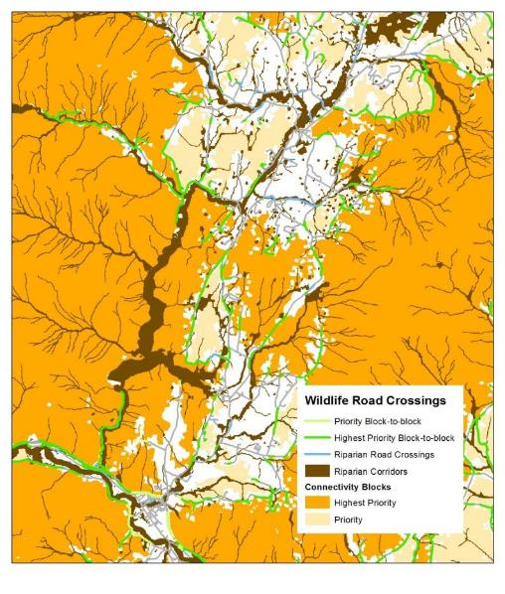

Wildlife Road Crossings
Definition: A section of road with high structural connectivity between two forest blocks or along a riparian corridor.
Ecological Function:
Provide the best opportunity for wildlife movement and dispersal of other species across roads
Wildlife road crossings over or under roads are critically important between adjacent forest blocks and along linear riparian area networks.
Waterbury-Stowe area

Slide 25
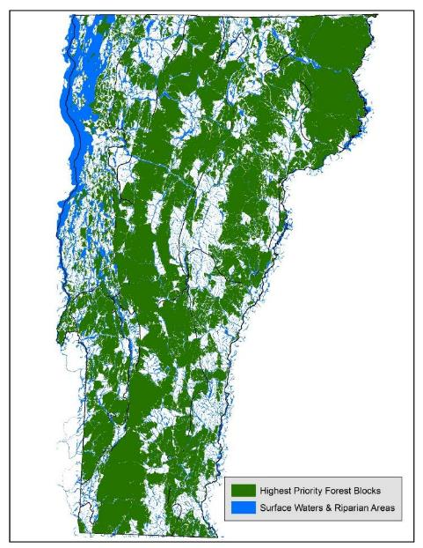
Putting it All Together: The Ecologically Functional Landscape
Large areas of connected forest, aquatic systems and riparian areas, natural communities that allow ecological processes to occur and species to access required habitat and shift across the landscape in response to climate and land-use change
“Conservation” in all its forms.

Slide 26

Some Thoughts and Perspectives
We should expect some decline in function – we cannot conserve it all.
There is still a lot of opportunity in Vermont : keep forests as forests and restore riparian areas.
80 percent of Vermont is privately owned. Landowners decisions on management and stewardship hold the key.

Slide 27
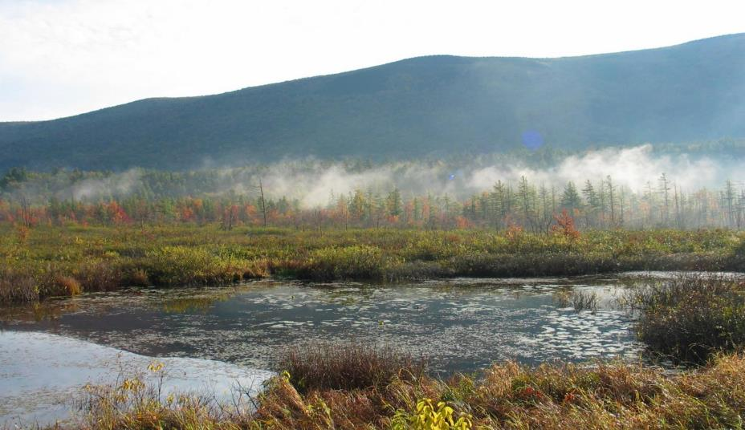
Thank you… Questions?

